Slide 1
Project 1
Lab Name：VCSDL (Video and Communication System Design Lab)
Advisor： Prof. Kuo Chih Hong
Group： Group 32
Team Members：J.W Wu, J.H Hu

Slide 2
Outline
FIFO
Simulation Results
Verification Techniques and Properties
  Scoreboard3
  SVA Code
Bugs Injection and Re-Verification

Slide 3
Outline
FIFO
Simulation Results
Verification Techniques and Properties
  Scoreboard3
  SVA Code
Bugs Injection and Re-Verification

Slide 4
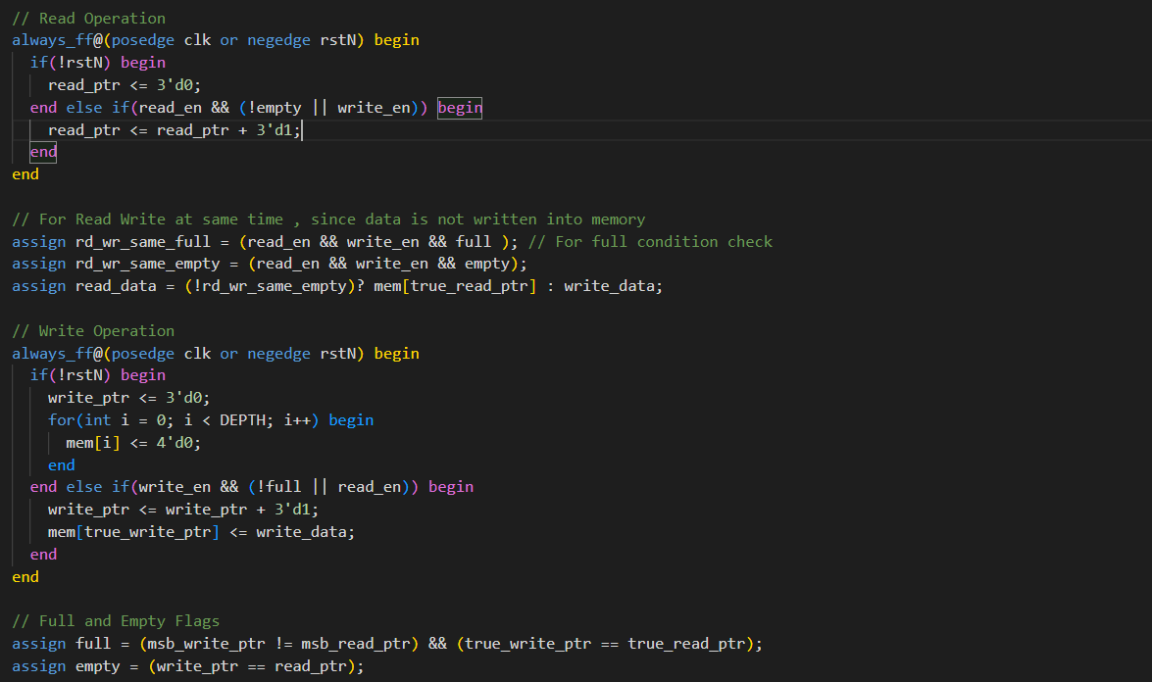
FIFO
FIFO source code

Slide 5
Outline
FIFO
Simulation Results
Verification Techniques and Properties
  Scoreboard3
  SVA Code
Bugs Injection and Re-Verification

Slide 6
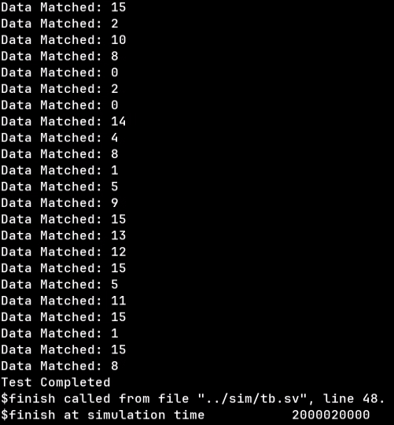
Simulation Results
Target :
  Overflow Detection
  Underflow Detection
  Data Integrity

Slide 7
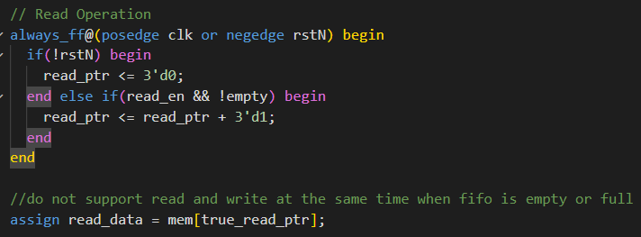
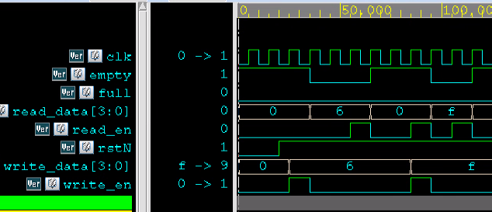
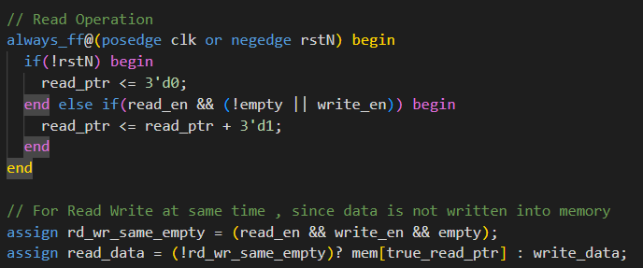
Simulation Results (Only One Case)

Slide 8
Outline
FIFO
Simulation Results
Verification Techniques and Properties
  Scoreboard3
  SVA Code
Bugs Injection and Re-Verification

Slide 9
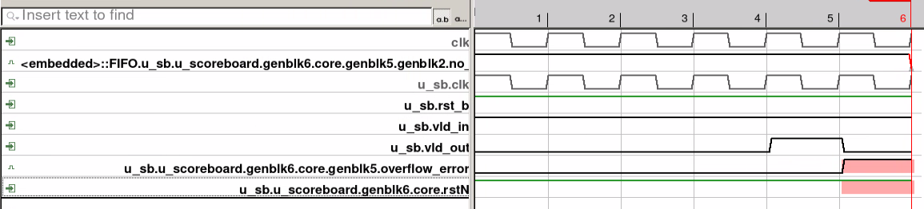
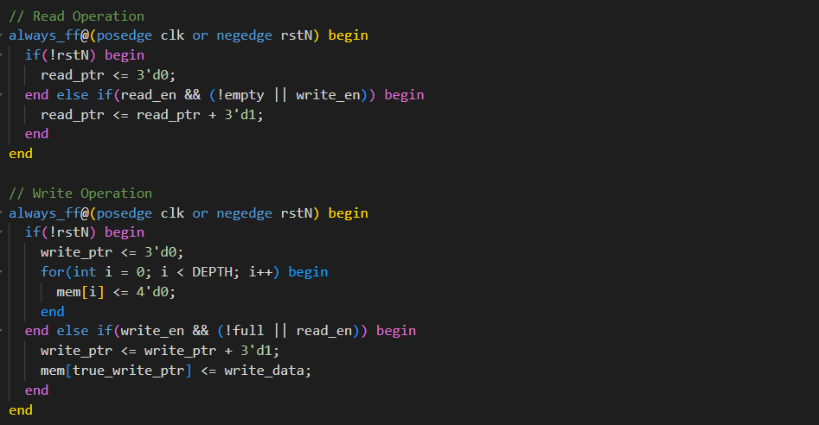
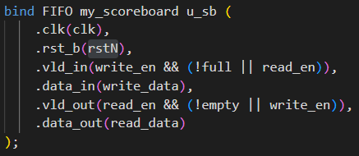
Scoreboard3
Bugs Found
How to fix it
Interface and Binding

Slide 10
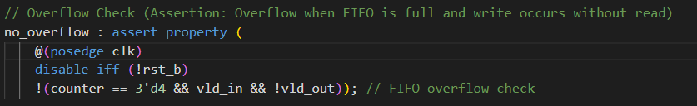
SVA
SVA Property : 在Scoreboard滿時不能只進行寫操作不進行讀操作
Property: no_overflow
Jasper Result:

Slide 11
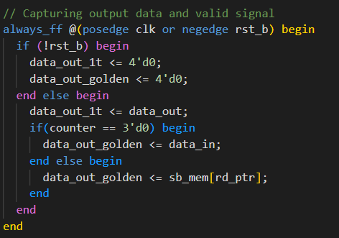
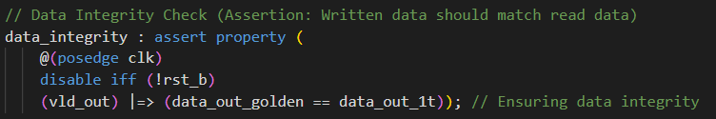
SVA
SVA Property : ScoreBoard讀出時，讀取出的資料必須和存取在ScoreBoard內最前面的資料相同
Property: data_integrity
Jasper Result:

Slide 12
Outline
FIFO
Simulation Results
Verification Techniques and Properties
  Scoreboard3
  SVA Code
Bugs Injection and Re-Verification

Slide 13
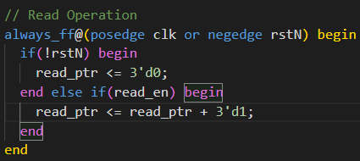
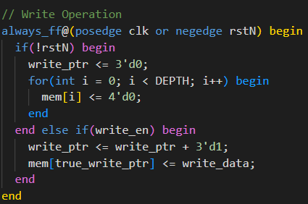
Bugs Injection
What is the bug(s)：empty時無法同時讀寫，並且可能overflow或underflow

Slide 14
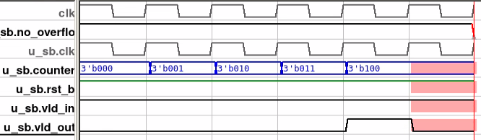
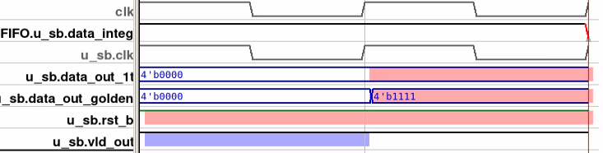
Re-Verification
Our scoreboard
Overflow
Data Integrity

Slide 15
Thanks for attention

